Slide 1

Kowshik Chilamkurthy
IIT MADRAS

Slide 2
Problem Overview
Develop a machine learning classification model to predict Event/Non-Event of lung cancer
Model is trained on 1,389 patients in train sample using “Lung Cancer” as target variable
Developed model should be able to predict the Event/Non-Event of lung cancer for 596 patients
Model should be able to find out the important variables in the training set which have considerable contribution towards the predictions
Choose right metrics to access the classification model’s goodness of fit
Challenges
Very Less training data to train a generic classification model
Dealing with categorical features
Feature Engineering
Tuning a standard generic models for a good fit on less training data

Slide 3
Process Followed
Cross validation
Data Storing
Pre-processing
Feature Engineering
Parametric Tuning
Training and predicting
Data Pre-processing
Encoding the categorical features, Which basically turns out every categorical variable in a categorical feature as a different feature , this increases the dimensions of training data
One-Hot-Encoding is used for encoding, which Transforms lists of feature-value mappings to vectors
When feature values are strings, this transformer will do a binary one-hot I.e. for example ‘0.333’,’0.6666’,’0.999’ is encoded as [0,0,1],[0,1,0],[1,0,0].

Slide 4
Feature Engineering
Sparsified data(1386x89) is subjected Tree-based estimators (GBM),which is used to compute importance of features
Meta-transformer for selecting features whose importance is greater or equal to a certain threshold value are kept while the others are discarded
After Feature Reduction the dimension of data is (1386x30)
‘Top 15 features are displayed in the Pie chart

Slide 5
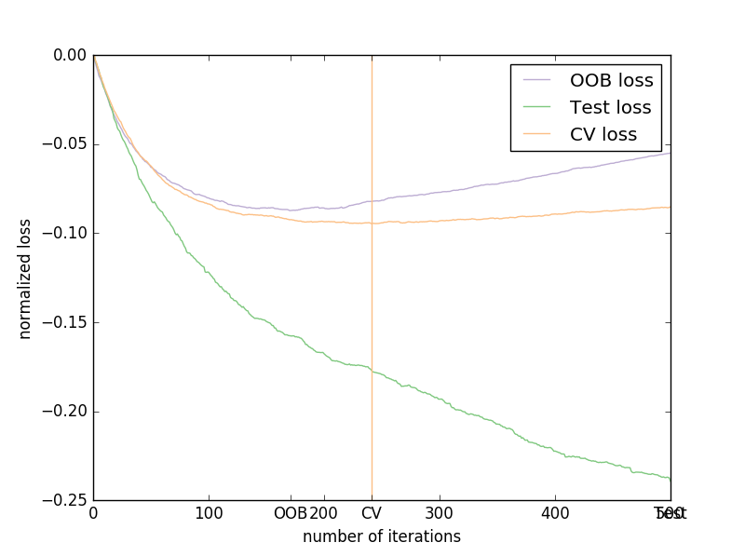
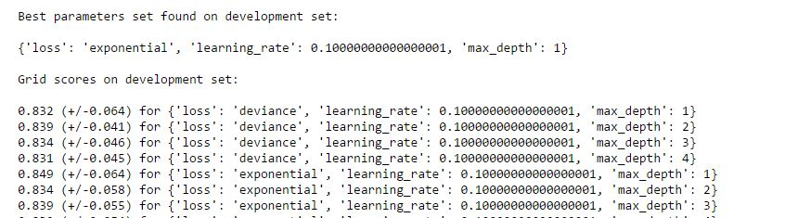
Parametric Tuning
A Basic Gradient Boosting trees are subjected to parametric tuning
At first tuning of boosting stages(n_estimators) is done by running a iteration to minimise cross validation loss
Then Maximum depth, learning rate, loss function parameters are tuned by using a grid search algorithm.
Best Parameters are n_estimators = 241, loss = exponential, learning rate = 0.1, depth = 1

Slide 6
Training and predicting
The Gradient boosting trees classifier is tuned accordingly
The classification model is trained by using the reduced training data(1386x30)
The goodness of the fit of the classification model is accessed by K-Fold cross validation with 15 folds
Event/Non-Event of lung cancer is predicted by running the model on the processed testing set
K-Fold cross validation
Split dataset into k consecutive folds without shuffling by default
Each fold is then used a validation set once while the k - 1 remaining fold form the training set.
Average Cross Validation score : 0.874

Slide 7
Variable study
Data is first subjected to encoding and then feature reduction
This process will not let any important categorical variable of a categorical feature to slip out in feature reduction
By applying Basic Gradient Boosting trees on the un-sparsified training set, the importance of each feature is as follows

Slide 8
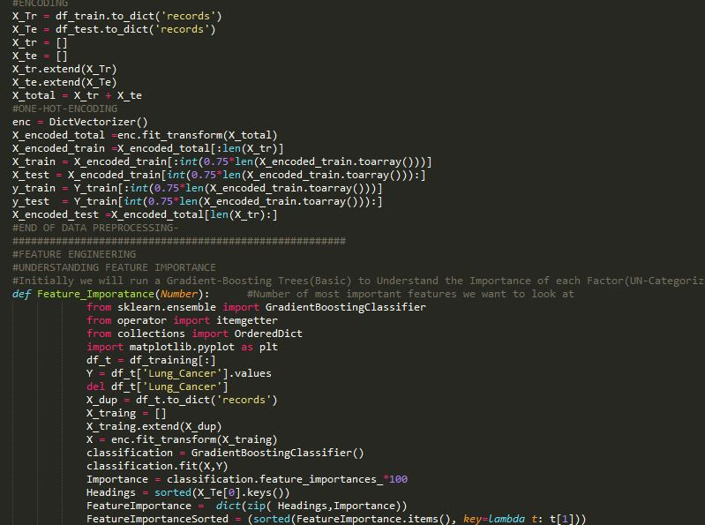
Code Specifications
Language : Python
Developed environment : Jupiter Ipython Notebook
Used Packages : Numpy, scipy, pandas, sklearn
Visualization package : Matplotlib
Output
Excel File with predictions
K-Fold Scores for 15-folds and an average score
Classification report
Excel Sheet with all K-Fold values

Slide 9
Model Diagnostic
Classification report for Train Split = 75% , Test split= 25%
Label | Precision | recall | F_1 score | support
Average | 0.93 | 0.93 | 0.92 | 348
K-fold Cross validation : 15 folds
Average score : 0.874

Slide 10
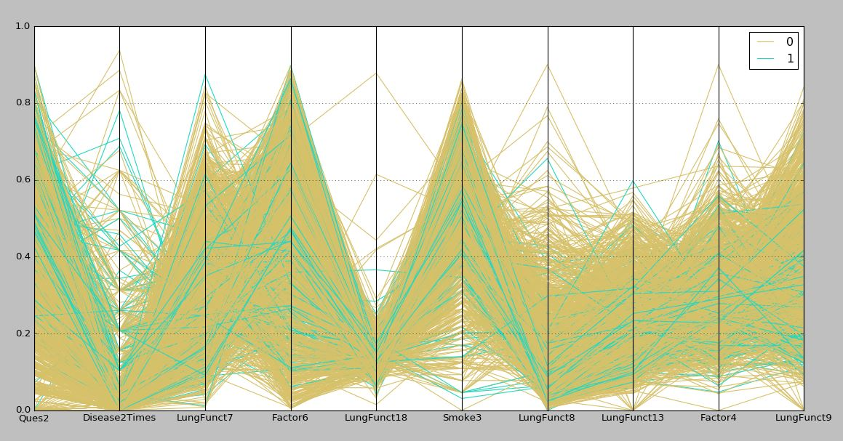
Visualization
Parallel axis plot is shown for only top 10 most important features
Parallel axis plot helps us to visualize high dimension data

Slide 11
Comments
The Data we have is considerably less in terms of training a generic model
It is good a take a generic model and tune it for learning on less training data
Deep neural nets are an option if we have a huge training data with good number of categorical variables
Feature Reduction is a very good option as the training data itself is small
Though it is tough to get a good score on testing data, training a robust model is always suggested
Recommendations
More data points for training could be an asset
Model can be even robust if it can perform collaborative filtering

